Slide 1

Collab: Trustless Collaboration Protocol
Enabling skilled strangers to work together, powered by Cardano Smart Contracts

Slide 2


The Trust Problem in Collaboration
Skills vs Character
Verifying technical abilities is straightforward - portfolios, tests, and demonstrations provide clear evidence.
Understanding character requires time, shared experiences, and often costly mistakes. This inhibits prospective collaborations or strains existing ones.
Key Insight: It's easier to audit code than to read minds. Smart contracts provide mathematical certainty where human trust falls short.

Slide 3

Can you collaborate
without trust?

Slide 4
Introducing Collab Protocol
Trustless by Design
Built on Cardano
Stranger-Safe
Smart contracts replace human trust with cryptographic guarantees and transparent logic.
Leveraging Cardano's research-driven approach for secure, scalable decentralized collaboration.
Work with anyone worldwide without reputation systems or lengthy vetting processes.
Trust the math, not the person. Verify contract logic once, collaborate with anyone.

Slide 5
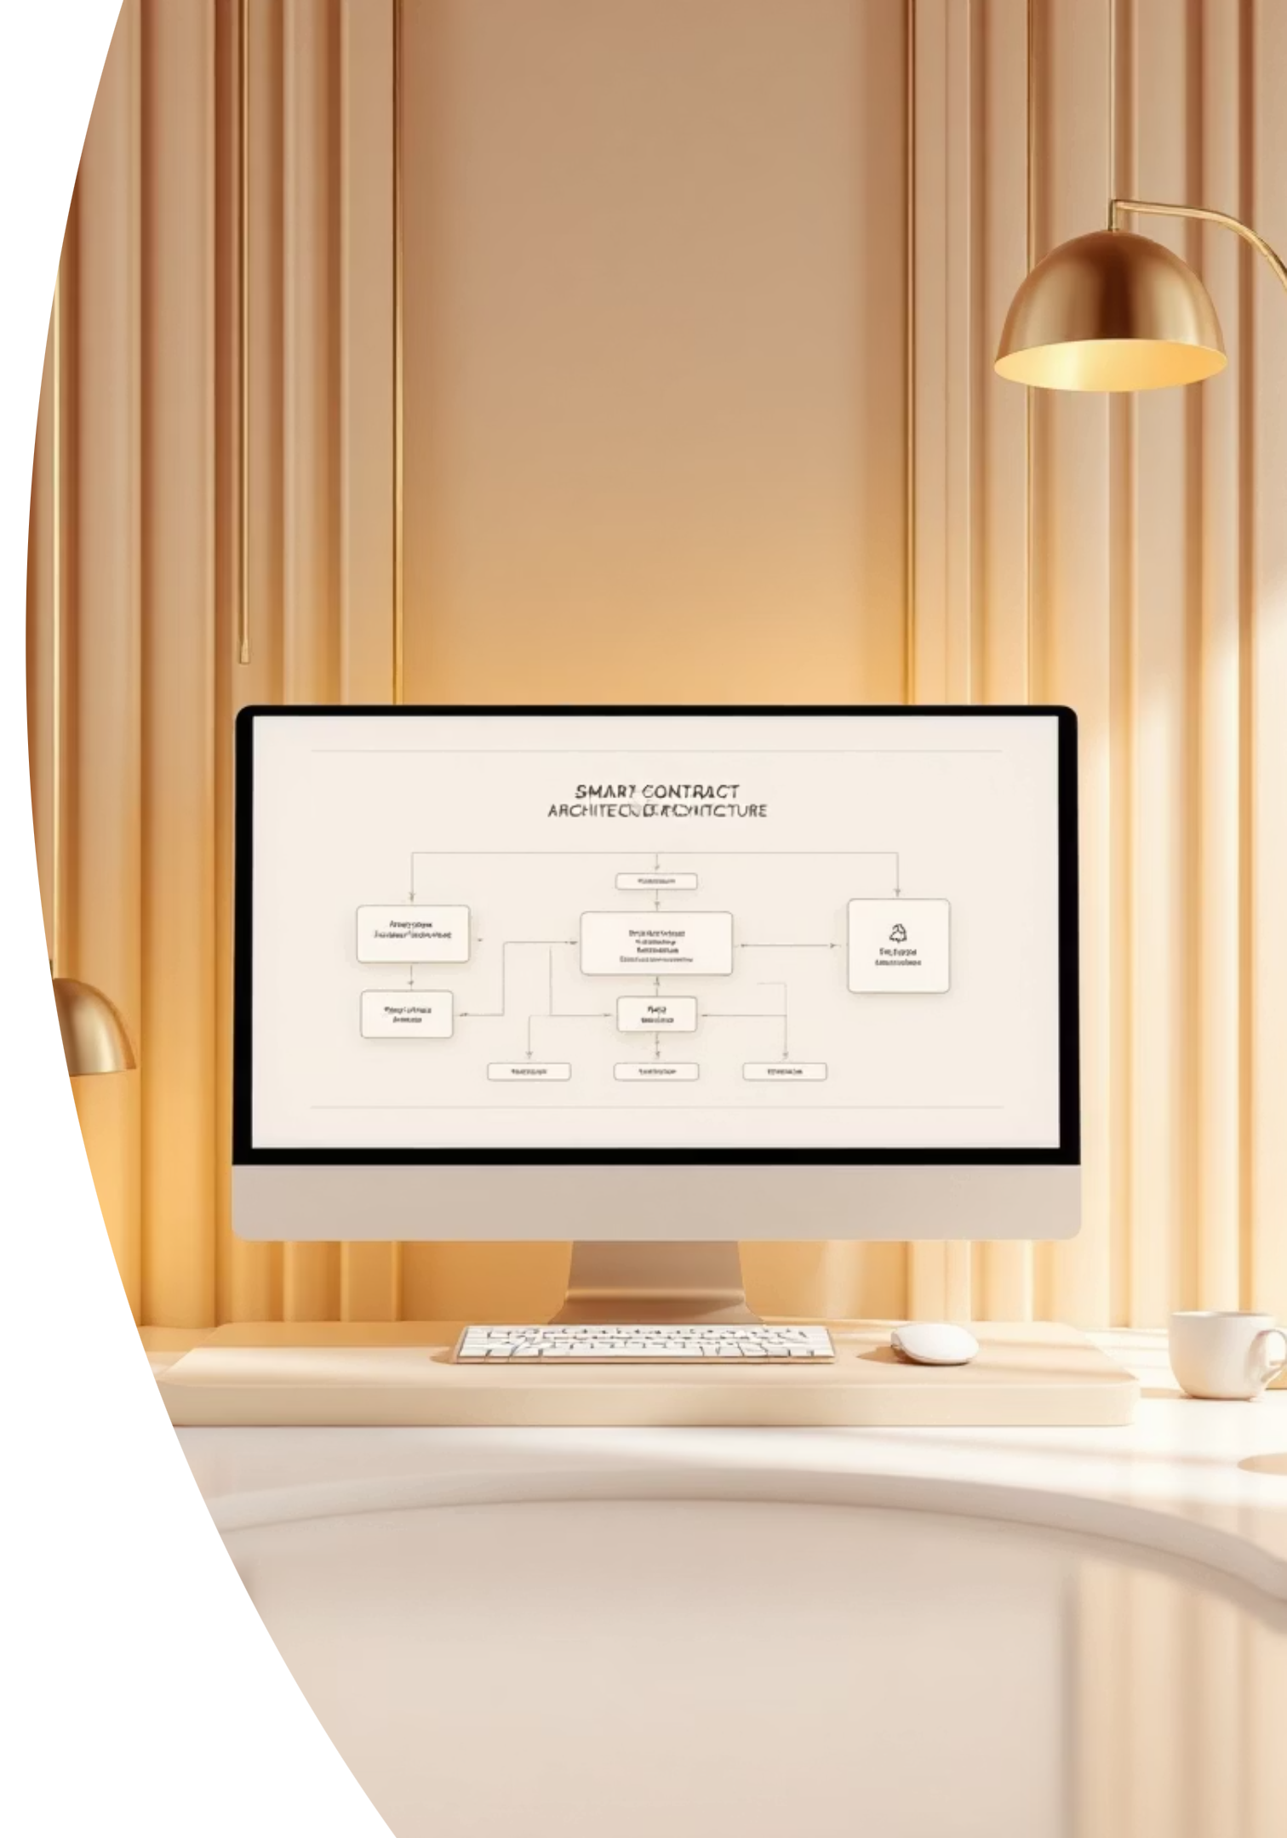
How Collab Works
01
02
Assemble Your Team
Create the Collab
Find capable collaborators who fit your project needs through any discovery method.
Deploy a smart contract specifying team members, credentials, and initial allocation percentages.
03
Client Pays Contract
Payment goes directly to the smart contract address, not any individual team member.

Slide 6

Smart Contract Architecture
Multi-Validator System
One-Shot Minting Policy: Creates unique Collab NFT using UTxO reference for guaranteed uniqueness
Spending Validator: Controls fund distribution and allocation updates
Collab NFT + Datum: Stores collaborator details, credentials, and current allocations on-chain
The contract address becomes the official payment destination, ensuring no single party controls funds.

Slide 7


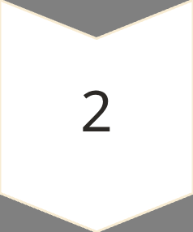

Real-World Flexibility
Why Allocation Finalization Matters
Initial estimates rarely match final contributions. Projects evolve, roles shift, and effort distribution changes organically.
Initial Estimate
Best guess at project start based on planned scope and responsibilities
Reality Check
Actual contributions become clear only after project completion
Fair Distribution
Final allocations reflect true value delivered by each collaborator

Slide 8

Consensus-Driven Finalization
All-or-Nothing Approach
Earnings are withheld until all collaborators cryptographically agree on final allocations, fostering honest negotiation and timely resolution.
Project Complete
Atomic Distribution
Work delivered, client payment secured.
Simultaneous earnings distribution.
1
2
3
Allocation Consensus
All members sign off on final percentages.

Slide 9




Key Benefits
Trustless Security
Global Talent Access
Mathematical guarantees replace reputation systems. Verify contract logic once, trust it forever.
Collaborate with the best talent worldwide without geographical or trust barriers.
Fair Distribution
Full Transparency
Consensus-based allocation ensures everyone receives compensation proportional to their contribution.
All contract terms, allocations, and transactions are publicly verifiable on-chain.

Slide 10

Ready to Collaborate Trustlessly?
Transform how strangers work together with cryptographic certainty instead of costly trust-building.
For Developers
For Project Owners
Build with global talent pools without reputation gatekeeping or trust overhead.
Access the best skills regardless of existing relationships or geographical boundaries.
For the Ecosystem
Enable meritocratic collaboration at scale through mathematical trust.

